Slide 1

Presentation on:
Network Function Virtualization: State-of-the-Art and Research Challenges
Arvendra Singh Kushwah (190183)
Tejas Shingte (190907)
Prof - Subrahmanya Swamy Peruru

Slide 2
Introduction: Network Function Virtualization (NFV)
NFV is a network architecture concept that seeks to virtualize a part of the network infrastructure.
NFV does not simply create virtual network devices such as routers or switches, but it virtualizes network functions.
NFV does not seek to replace all of the physical network infrastructure with a virtual version.
A network will always have a physical component because PCs, IP phones, tablets, mobile phones, and IP cameras are all physical devices
For enterprise networks, the portion of the network that NFV seeks to virtualize is centered on the datacenter, the location where the network services reside and are being provisioned, as well as on the network edge.
Notes:
that need either a cable or a wireless link to connect them to the network. The network requires a physical switch or a wireless access point to uplink these connections to the rest of the network.

Slide 3
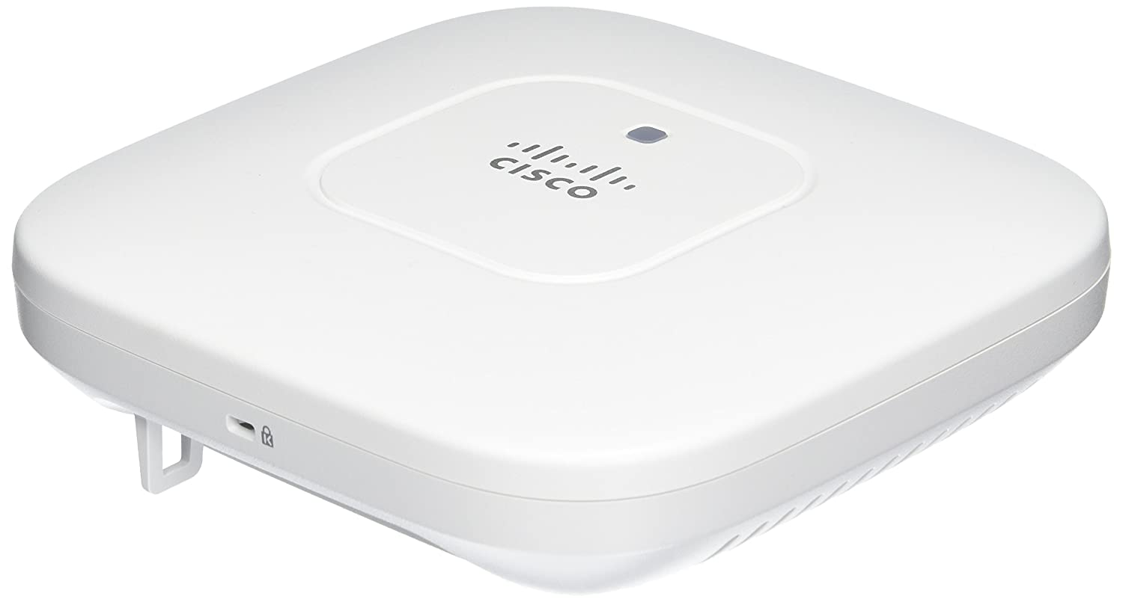
What are Network Functions and Services?
A network function (NF) is a function that is performed by a physical appliance like a router, switch, firewall, load balancer, IDS, WAN optimizer, etc.
Most vendors have proprietary solutions in which hardware and software are tightly coupled.
Physical Installation of these appliances are required on site, plus they require periodic replacement due to low life of hardwares.
This hardware deployment is a large barrier to entry for new vendors, hindering competition and innovations.
Moreover launching new services require huge capital investment and takes too long, as it often needs new proprietary hardware to be integrated into existing systems.
Network operators face an increasing disparity between costs and revenue.
Notes:
Cisco is a good example. They sell their routers and switches as appliances. You need the hardware and software. You cannot run Cisco IOS (officially) without the hardware and you can’t run anything else besides Cisco IOS on a router or switch.

Slide 4
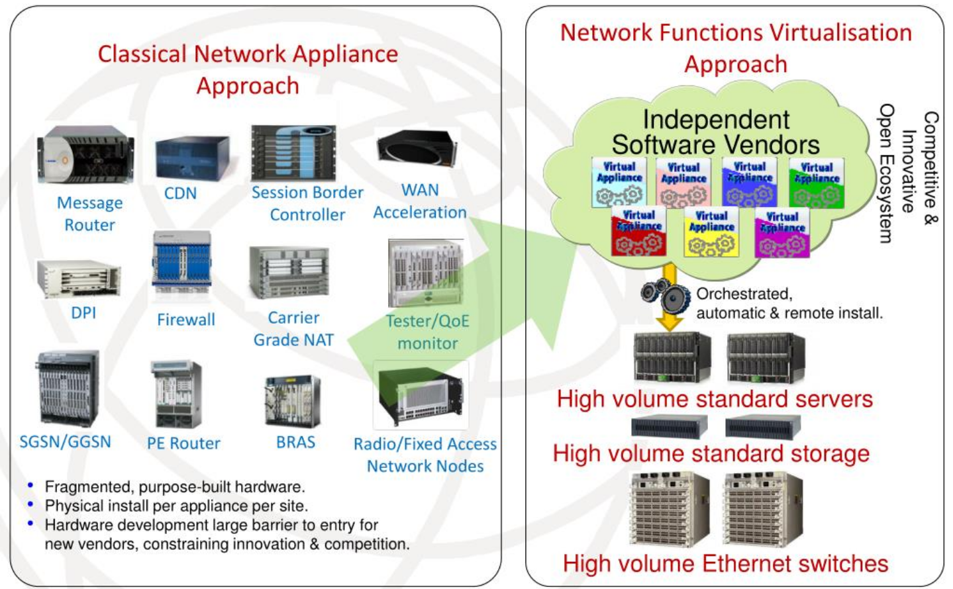
Network Function Virtualization(NFV)
Network function virtualization unlinks network services from proprietary hardware appliances, enabling them instead to run in virtual machines as software.
A virtual network function (VNF) is the software implementation of NF that can be deployed in a virtualized infrastructure VNF
These Independent Software vendors offer various VNFs and service providers can choose the VNFs that they need.
NFV allows multiple VNFs to run on just one server
This virtualization of infrastructure also typically results in more efficient use of data center resources.
But if we want to run VNFs from different vendors on a single open platform, we need a standard that describes how to manage, monitor, and configure our VNFs.
Image Source : https://www.slideserve.com/hayes/defining-nfv-nfv-network-function-virtualization-powerpoint-ppt-presentation
Notes:
Like some virtualized firewall or router etc
Network function virtualization allows multiple VNFs to be deployed on top of these switches, storage devices, and high-volume servers, a typical cloud computing infrastructure.
But if we or the TSP wants to

Slide 5
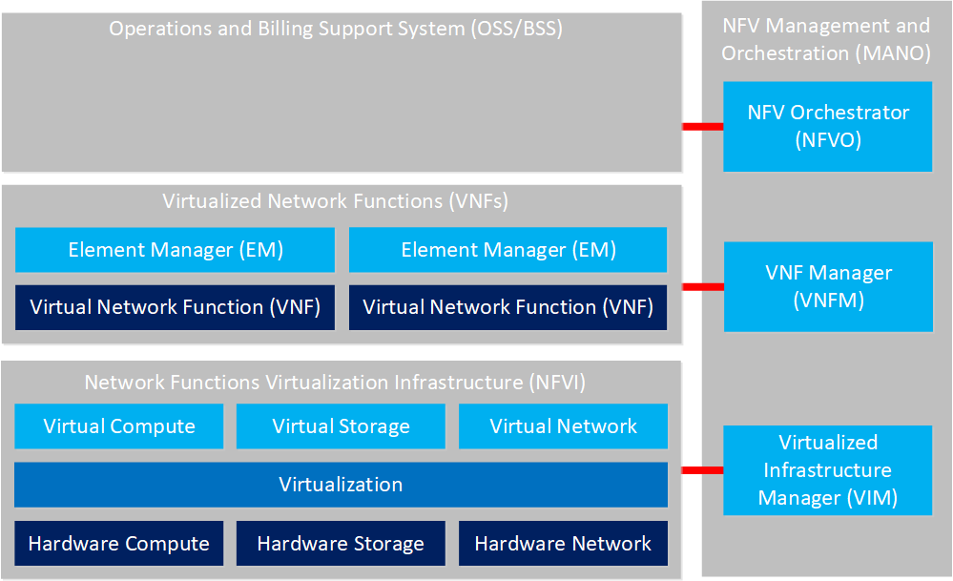
ETSI NFV Architectural Framework
The European Telecommunications Standards Institute (ETSI) created the Network Functions Virtualization (NFV) framework which describes standards to decouple network functions from proprietary hardware appliances and instead, run them in software on standard hardware.
The framework also describes how to manage and orchestrate VNFs.
There are four components in this framework:
Virtualized Network Functions (VNFs)
Network Functions Virtualization Infrastructure (NFVI)
NFV Management and Orchestration (MANO)
Operations and Billing Support System (OSS/BSS)
Image Source : https://networklessons.com/cisco/evolving-technologies/virtualization-functions-nfvi-vnf

Slide 6
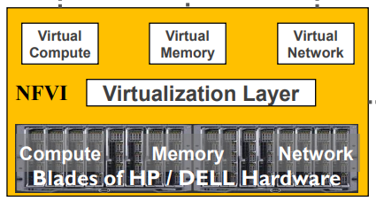
NFV Infrastructure (NFVI)
NFV infrastructure (NFVI) is all the hardware and software we need to create a platform where we can run VNFs on.
The physical resources include commercial-off-the shelf (COTS) computing hardware, storage and network (like switches) that provide processing, storage and connectivity to VNFs
Virtual resources are abstractions of the computing, storage and network resources.
The abstraction is achieved using a virtualization layer (based on a hypervisor).
Hypervisors make virtualization possible by translating requests between the physical and virtual resources.
Image Source: https://b5b4ea4f-167c-45d0-aff4-0c3477aaa89c.usrfiles.com/ugd/b5b4ea_2839ec7d42e547d9996fb297607556f7.pdf

Slide 7
NFV Management and Orchestration (MANO)
The NFV Management and Orchestration (MANO) component has three items:
NFV Orchestrator (NFVO): the orchestrator launches, maintains, and scales VNFs. The orchestrator also validates and authorizes resource requests from the NFVI component.
VNF Manager (VNFM): the VNFM performs life-cycle management (launch, maintain, and teardown) of VNFs.
Virtualized Infrastructure Manager (VIM): the VIM manages and controls the hardware and virtualization resources in the NFVI. It collects performance metrics, fault information, and also performs life-cycle management of all NFVI resources.
Image Source : https://networklessons.com/cisco/evolving-technologies/virtualization-functions-nfvi-vnf

Slide 8
Operations and Billing Support System (OSS/BSS)
The Operation Support System (OSS) supports management functions like network inventory, management, and configuration.
The Billing Support System (BSS) deals with customer management and includes systems for taking orders, payments, etc.
Image Source : https://networklessons.com/cisco/evolving-technologies/virtualization-functions-nfvi-vnf

Slide 9
Advantages of NFV
Greater Efficiency: Network function virtualization also allows multiple functions to run on a single server, eliminating proprietary physical hardware, consolidating resources, and reducing costs.
Reduced vendor lock-in: NFV allows standard COTS hardware to run network functions, replacing dedicated hardware.
Flexibility:
Shortens the time-to-market period by allowing for quick changes to the network infrastructure in support of new organizational goals and products.
NFV networks also adjust more rapidly to fluctuations in traffic and demand.
NFV networks scale the resources provided to them and the number of active VNFs up and down automatically using SDN software.
Notes:
NFV in IoT or another form of virtualized infrastructure enables increased workload capacity with less—less power consumption, a smaller data center footprint, and similar or reduced cooling requirements.
so they help avoid vendor lock-in and proprietary hardware that is expensive to configure and deploy and can easily become obsolete.

Slide 10
Cloud Computing
Cloud computing is aimed at self-service provisioning across tenants.
A tenant may be a project, department, division, or even a different company. As such, security becomes very important.
There are multiple models associated with cloud computing; major categories include:
Infrastructure as a Service (IaaS): Making VMs available to customers with the physical hardware (servers, storage, and networking) managed by the service provider.
Platform as a Service (PaaS): The development platform for programmers is provided as a service while all the details about the physical and virtual equipment is abstracted from the developer and managed by the service provider.
Software as a Service (SaaS): An application (such as email or contact management) is made available to customers while all the details of the underlying platform are abstracted from the customer.

Slide 11
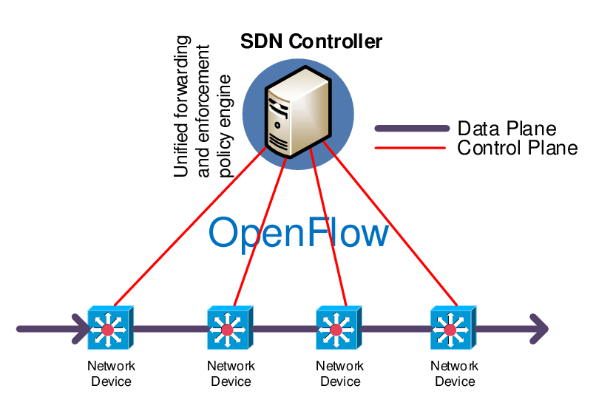
Software Defined Networking (SDN)
SDN changes how networking is fundamentally done.
Instead of having network intelligence distributed across every device, SDN aims to centralize command and control in a master device (or a few of them for redundancy) and to split networking into three planes, namely:
Management: This is the interface you use to orchestrate the entire network, specifying the way you wish the network to be run at a high level.
Control: This is where all the individual devices are directed from using the inputs from the management layer, translating management directives into the actual commands the data layer use to move traffic around.
Data: This is where the data is actually moved from one device to another.
Image Source : https://www.researchgate.net/figure/A-schematic-overview-of-SDN-implemented-with-OpenFlow_fig1_288890479

Slide 12
Advantages of using SDN
Actual data layer devices can be much simpler and thus less expensive as they don't have to decide what to do with each packet they receive.
SDN is a great option for large, complex networks that require lots of up-time. It gives engineers the ability to re-route networks on the fly.
SDN offers real-time visibility into your network performance. This visibility gives you the ability to optimize your network’s performance and to drive its efficiency (as well as that of your team’s).
SDN offers automated scaling-up (and scaling down). This ability, combined with the additional visibility it brings, gives engineers the operational ability to normalize traffic across a wide space, and to do it quickly and seamlessly.
Image Source : https://www.researchgate.net/figure/A-schematic-overview-of-SDN-implemented-with-OpenFlow_fig1_288890479
Notes:
For example in traditional network each router generally has its own control plane which contains forwarding table and all to decide where to redirect the incoming data, but in SDN central device decides that for all routers so router need no to be smart, and are muh less expensive.
For example, when an outage occurs, a software defined network can be configured to automatically reroute around that area and maintain the connections your users need.
In the past, the most effective way to ensure network availability was through redundancy, which of course comes with additional equipment and circuits and costs. Because SDN offers the real-time ability of automated rerouting or to stand-up new functions and routes,

Slide 13
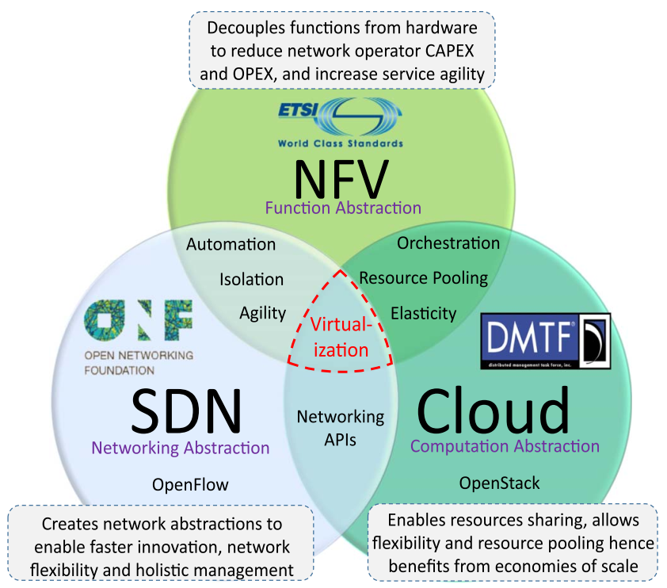
SDN, NFV and Cloud Computing
Each of these fields is an abstraction of different resources: compute for cloud computing, network for SDN, and functions for NFV
NFV goals can be achieved using non SDN mechanisms, and relying on the techniques currently in use in many data centers.
However, approaches relying on the separation of the control and data forwarding planes as proposed by SDN can enhance performance, simplify compatibility with existing deployments, and facilitate operation and maintenance procedures.
In the same way, NFV is able to support SDN by providing the infrastructure upon which the SDN software can be run.
Finally, the modern variant of a data center (the cloud and it’s self-service aspect) relies on automated management that may be obtained from SDN and NFV.
In particular, aspects such as network as a service, load balancing, firewall, VPN etc. all run in software instantiated via APIs.

Slide 14
NFV Design Considerations
While NFVs are a very promising solution, they have to meet certain requirements before replacing TSPs. The following parameters have been identified
Network Architecture and Performance
Security and Resilience
Reliability and Availability
Support for Heterogeneity
Legacy Support
Network Scalability and Automation

Slide 15
Network Architecture and Performance
NFV architecture should be able to achieve performance similar to that obtained from functions running on dedicated hardware.
Certain VNFs (example DPI) are network and computation intensive and may require some form of hardware acceleration to be provided by the NFVI to still meet their performance goals
VNFs should only be allocated the storage and computation resources they need

Slide 16
Security and Resilience
Functions/Services from different subscribers should be protected/isolated from each other
The NFVI should be protected from the delivered subscriber services
Proposed solutions:
Deploying internal firewalls within the virtual environment
To make service deployment resilient it may be necessary for functions that make up the same service not be hosted by physical resources in the same fault or security domain during deployment

Slide 17
Reliability,Availability,Heterogeneity,
Legacy Support, Network Scalability and Automation
Outages have to be in milliseconds and in case of service impacting outages need to be limited
An important aspect of NFV is enabling openness and freedom from vendor dependency
Compatible with physical NFs
The network should be scalable and responsive

Slide 18
Challenges of NFV
Challenges in network function virtualization are centered in three aspects of the approach: the VNFs, the NFV manager (NFVM), and the NFV infrastructure (NFVi).
Because these three components are so heavily dependent on each other, implementing them at a large working scale is complex.
Complexity arises at three points of integration:
when the NFV manager and existing computational infrastructure integrate,
when the NFV manager and the VNFs integrate, and
when various components of the NFV manager must coordinate their activities.
Multiple organizations have worked to standardize NFV tools over time has driven this complexity.
This has evolved into many standards which works well for these organizations own use.
Notes:
These three are precisely the function of NFV MANO in the ETSI’s NFV Architecture that we discussed earlier

Slide 19
References
Paper: https://ieeexplore.ieee.org/document/7243304
https://www.vmware.com/topics/glossary/content/hypervisor.html
https://b5b4ea4f-167c-45d0-aff4-0c3477aaa89c.usrfiles.com/ugd/b5b4ea_2839ec7d42e547d9996fb297607556f7.pdf
https://networklessons.com/cisco/evolving-technologies/virtualization-functions-nfvi-vnf
https://www.slideserve.com/hayes/defining-nfv-nfv-network-function-virtualization-powerpoint-ppt-presentation
http://novacontext.com/sdn-and-cloud-computing/
https://www.gdit.com/perspectives/latest/4-benefits-of-moving-to-software-defined-networking
https://www.sciencedirect.com/topics/computer-science/network-function-virtualization
https://info.teledynamics.com/blog/network-function-virtualization-nfv-and-its-benefits-for-voip

